Slide 1



Reinforcement Learning
+
Tom Vodopivec
IADS Analytics, Data Science & Decision Making Summer School 2022 2022-08-01

Slide 2

The Field
Artiﬁcial Intelligence > Machine Learning
(A special case of) supervised learning
+
But also has elements of unsupervised learning

Slide 3

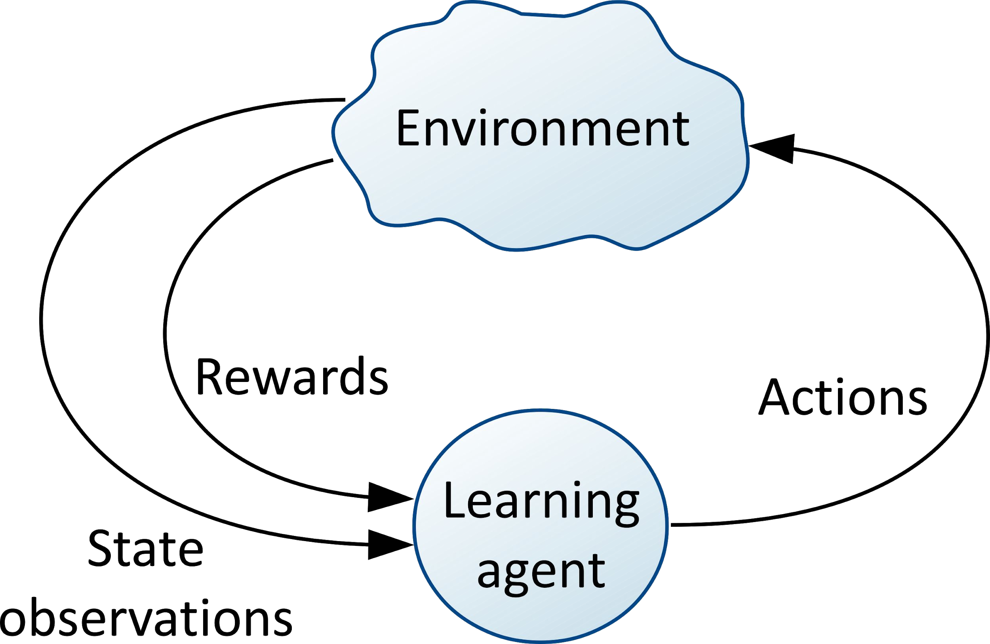
//////
The Reinforcement Learning Setting

Slide 4
The Reinforcement Learning Setting
Agent
Behaviour > Actions
Environment States
Rewards > deﬁne the goal of the agent
+

Slide 5
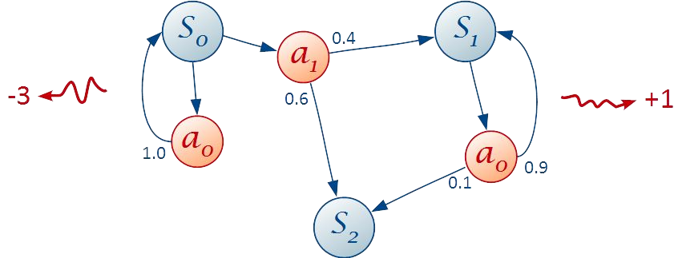
Markov Decision Processes
States Actions Rewards
Transition probabilities
+
Go form one node to another node = a time step
Going through the entire algorithm and ending in terminal state/node = once = an episode

Slide 6
Markov Decision Processes Key Concepts
Trajectory (concept of time)
(Expected) return -> exploration vs exploitation dilemma
Discount rate -> contingency -> further in time a reward happens -> less related to what is happens now.
+
Continuing vs. episodic tasks -> different types of nodes in network
T erminal states -> a node in the network where episode ends. = no stepping forward
Non-stationary MDPs | -> how the environment is designed
Partially-observable MDPs |

Slide 7
What to Learn From?
Experience = Samples of interaction with environment
i.e., nodes get metric information = info about their state = what you use to learn
Real (learning)
Simulated (planning)
+
Exploration-exploitation trade-off
Uncertainty -> of your chance to increase output, you work based on information you got from the past (i.e., what you have learned) and hope that this information still holds. However, could be the environment has changed.

Slide 8
How to Store Knowledge?
State-value function -> when you get to a node, see what the state situation is . What value does this state has = how beneficial would it be to my current behaviour (i.e., how you chose one path/node over another, e.g., random (always 50/50) or the best one based on a matrix X, in light of my goal (reward maximization)
Action-value function ->
Behavior policy -> change your actions based on what you learn, e.g., assign probability of chance to choose one path vs another. Either hard coded or relative to metric, so will change. E.g., start with going randomly 50/50 choosing. Then becomes 70/30
Model (of the environment) -> hhh
+

Slide 9
How to Store Knowledge?
Representations -> of the data/ metrics of nodes on a network
Tabular vs. approximate -> approximate neural network = what used most irl and in practice
Fixed vs. adaptive
+

Slide 10
Updating Knowledge = Learning
Goal: learn optimal (behavioural) policy (and optimal state - action value function)
Mathematically proven -> will eventually get the optimal solution. How many steps it will take depends on size of space
Generalized policy iteration
Policy evaluation -> e.g., check state-action values = how you monitor how well you behave under the current set up of node/metric values
Policy improvement-> if outcome not as good as you want it-> can change values of e.g., probability.
+
Algorithms
Model-based
Model-free

Slide 11
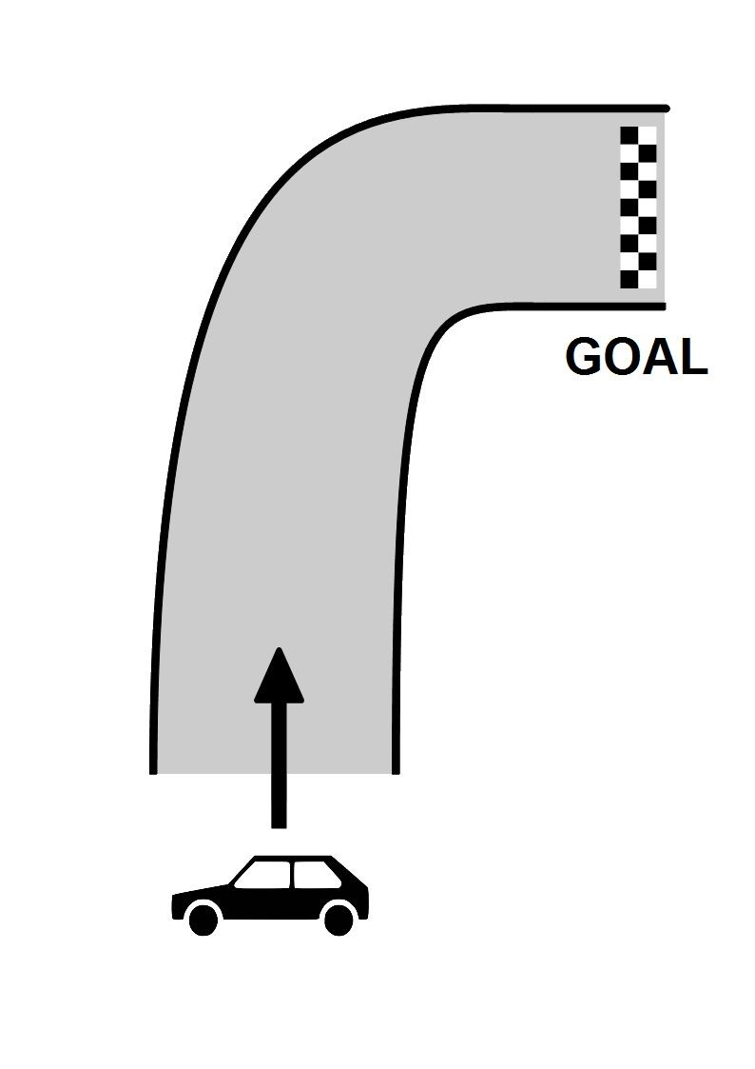
Race Track Example
+
11/16

Slide 12
Algorithms
Dynamic programming: policy iteration, value iteration
Monte Carlo
+
Temporal-difference learning: TD(λ), Sarsa, Q-learning, Deep Q-learning
Bootstrapping
Eligibility traces
Policy gradient and Actor-Critic: REINFORCE
12/16

Slide 13
Applications
Games: AlphaGo, AlphaZero
Scheduling tasks: optimization of memory control Modelling bird movement
Web services / optimization
+
13/16

Slide 14
Reading Material
Quick and practical state-of-the-art:
Thomas Simonini, Deep Reinforcement Learning course
Most comprehensive and best foundations:
d S. Sutton and Andrew G. Barto, Reinforcement Learning, An introduction, second edition
+
Outstanding applications:
Silver et al., AlphaGo, AlphaGo Zero, AlphaZero
14/16

Slide 15
Recap
Agent, actions, environnement, state, rewards
Explore and collect experience Representation of knowledge Update knowledge = learn Improve behaviour
+
15/16

Slide 16
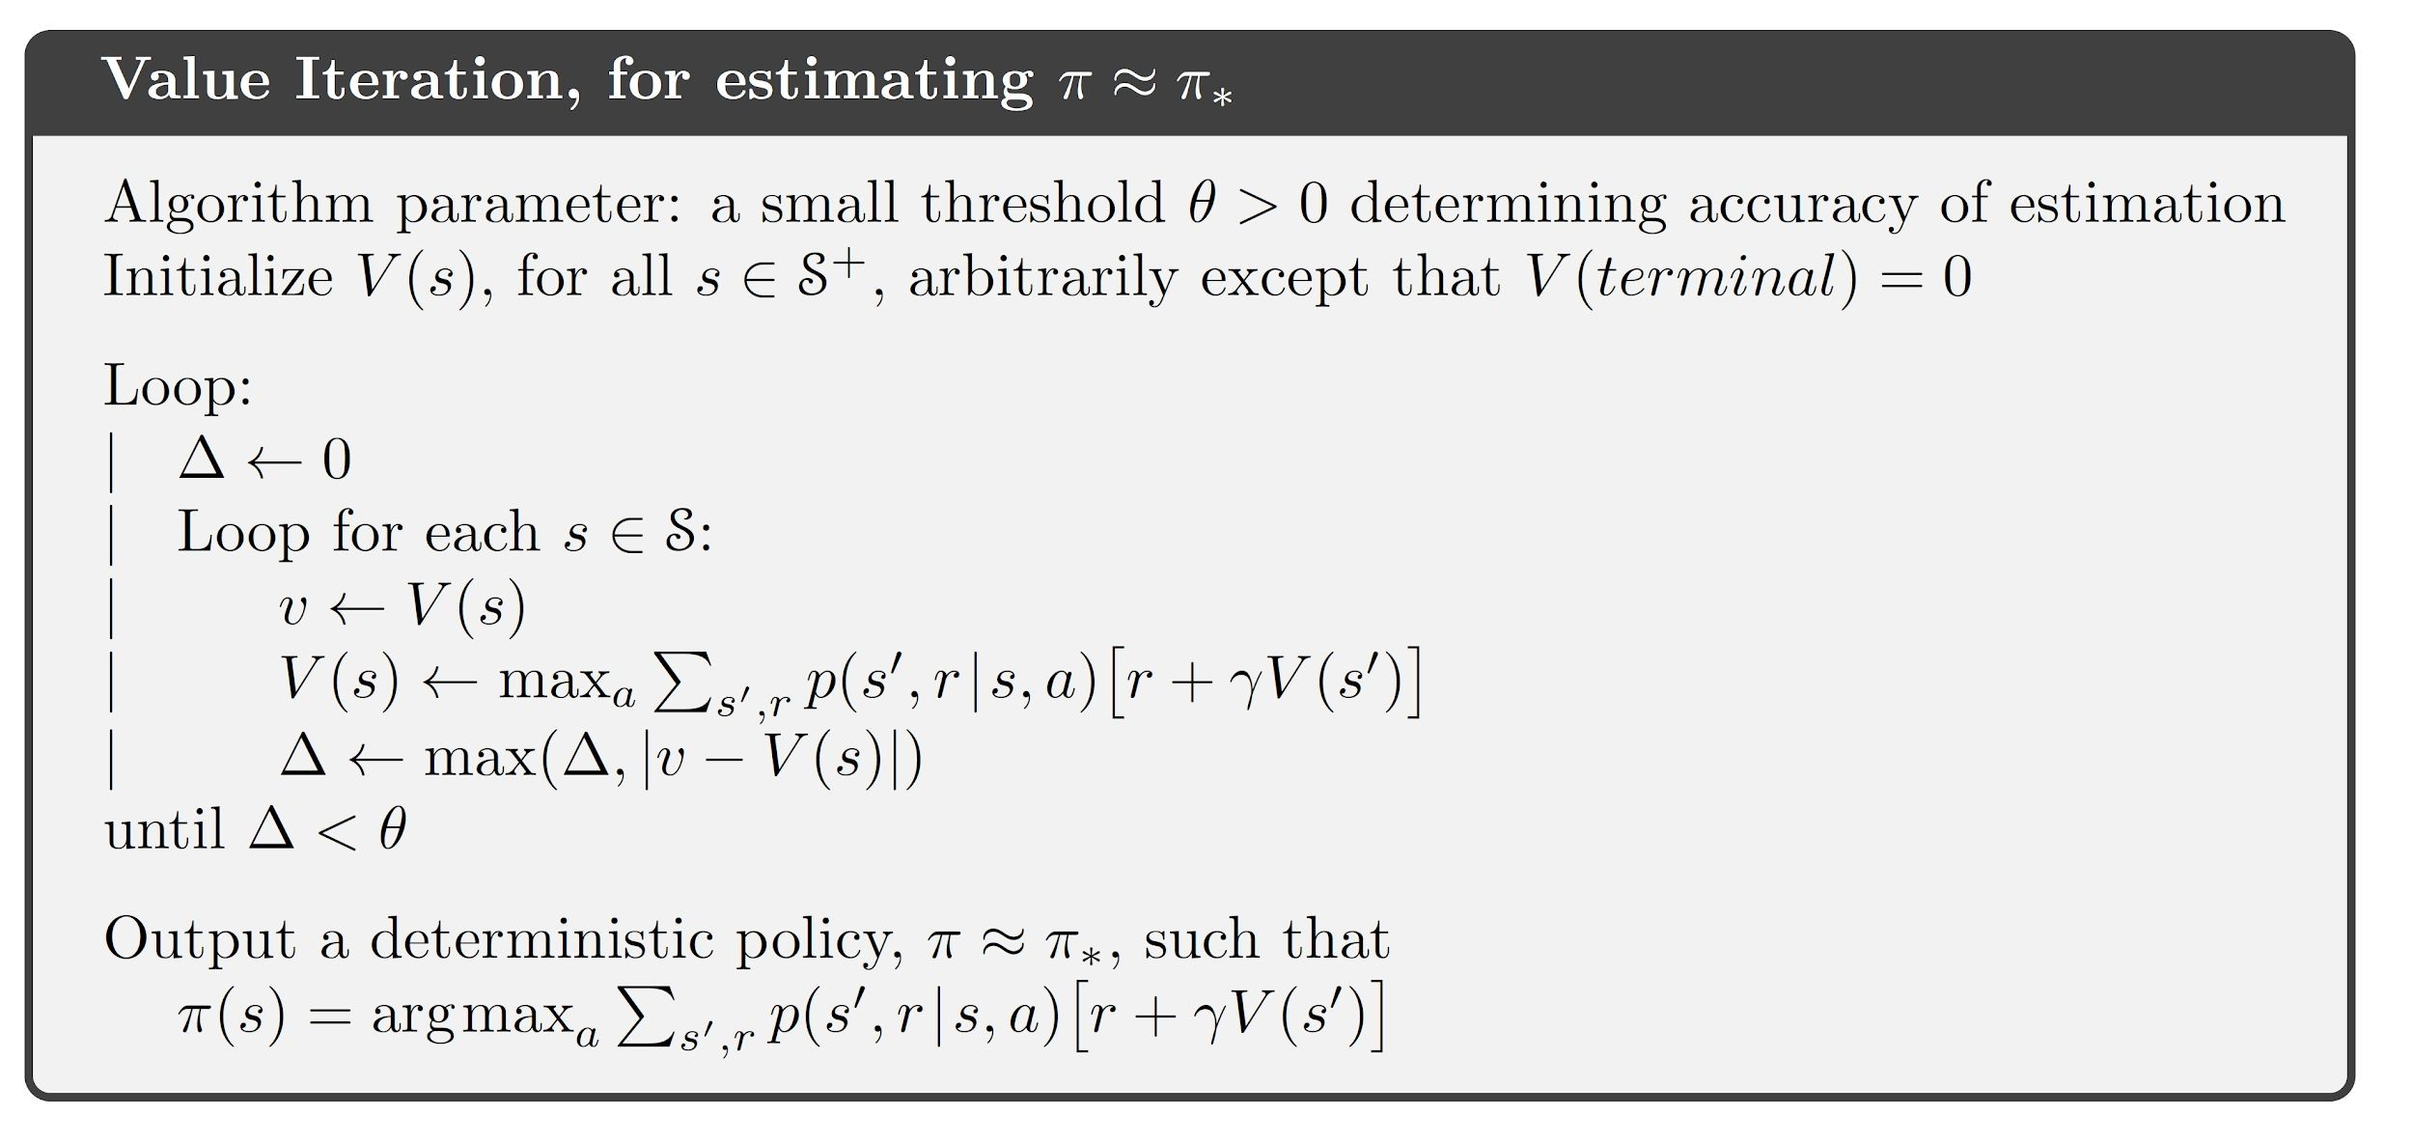
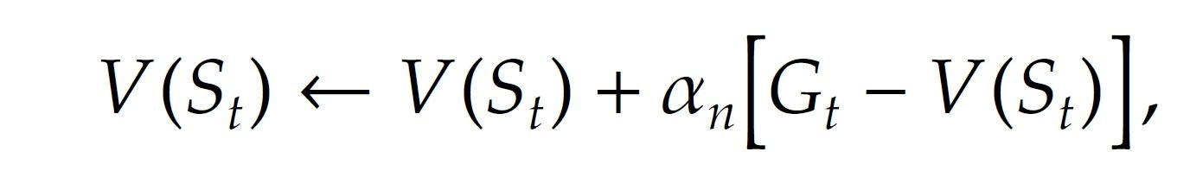
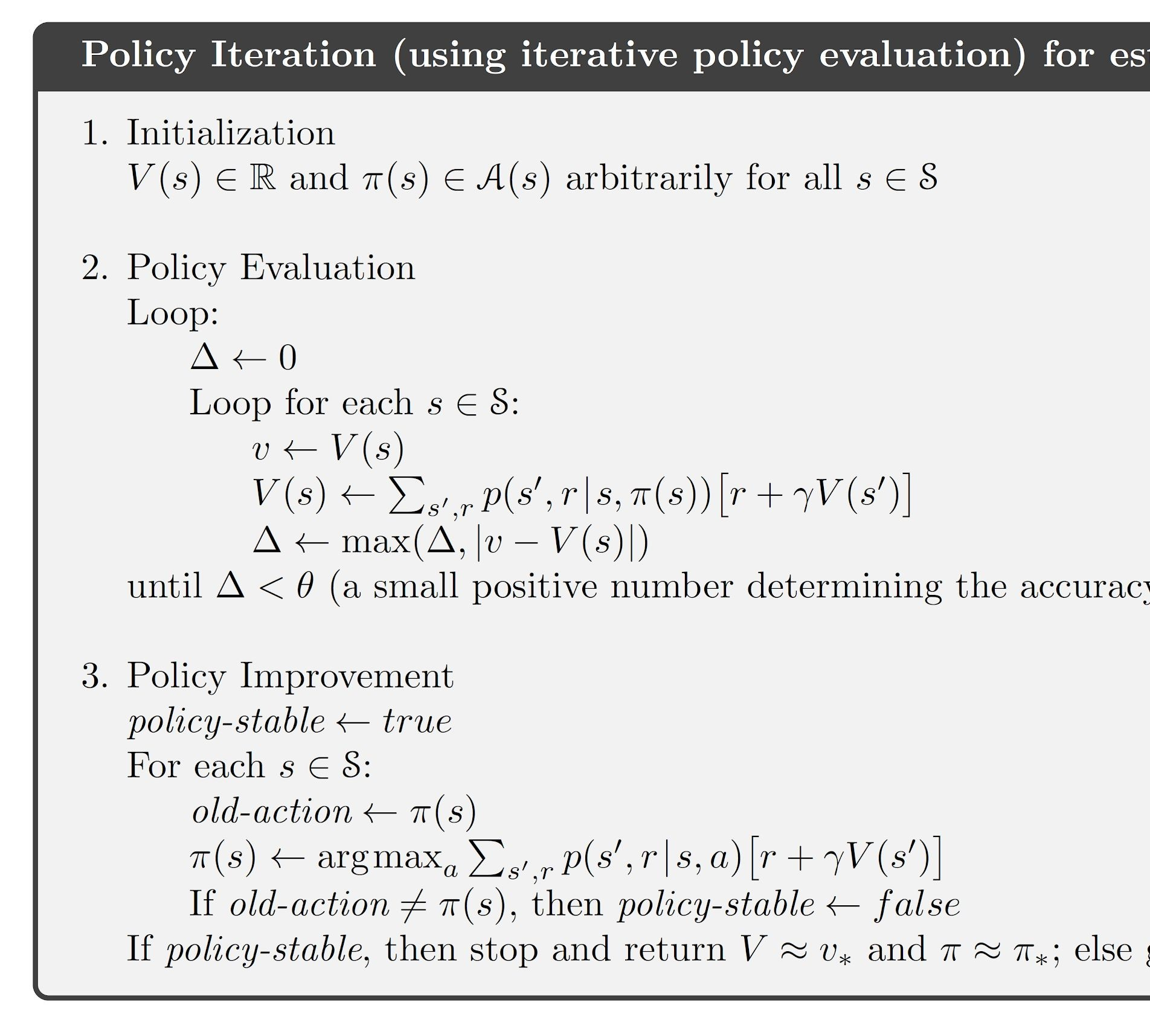
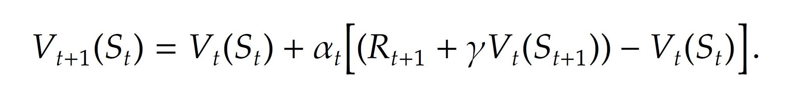
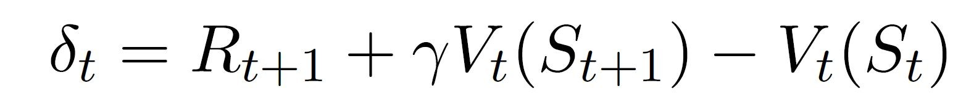
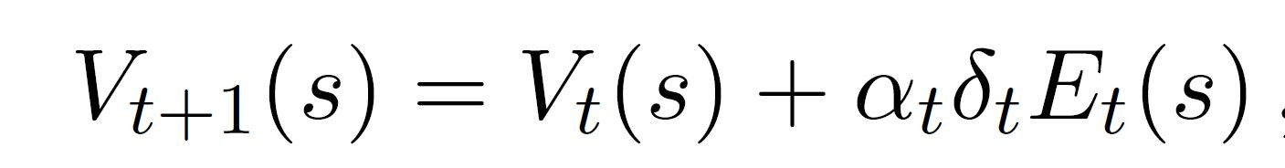
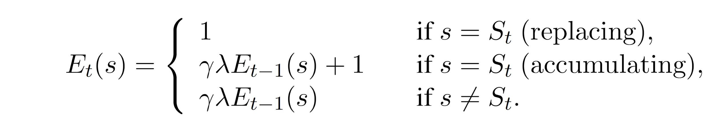
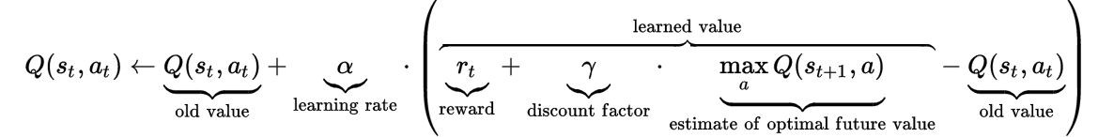
//////
Equations
17

